Slide 1

Small Business Customer Management System (CMS)
Theme- SDG 8: Decent Work and Economic Growth
SDG 9: Industry, Innovation, and Infrastructure
SDG 12: Responsible Consumption and Production
Category- Software
Group No -16
Group Members-Devashish Jha, Swayam Kale, Akshay Hegde, Nandan gurav
Guide- Prof. Sushmita Madineni

Slide 2
Outline
Introduction
Literature Survey
Limitations of existing systems
Problem statement and Objectives
Proposed Methodology
Experimental Setup
Implementation
Results & Analysis
Conclusion and Future work
References

Slide 3

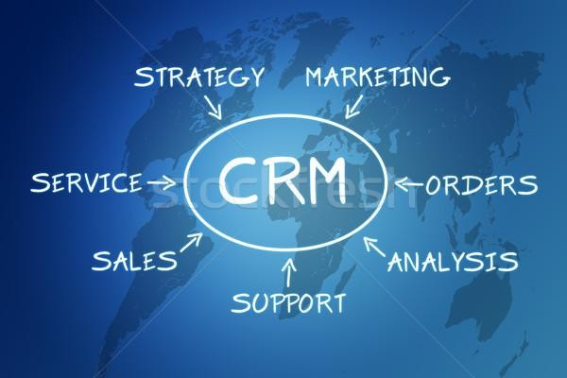
Introduction
Small Business Customer Management System
Helps shop owners to manages daily customer and sales data
Works as a digital notebook for small business owners
Provide safe Digital storage for customer storage
Supports small retail shops and electronic stores
Current Challenges faced by small business owners
Data loss due to damaged notebooks
Small business owners waste time calculating profit manually
There is no proper system to store customer data
Hard to track daily profit & sales

Slide 4
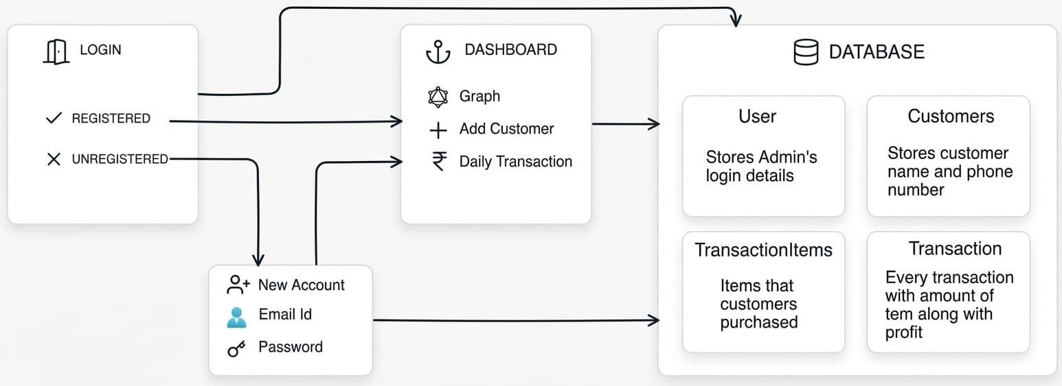
Introduction
Working of the System

Slide 5

Literature survey
Traditional solution and changes
Most shop owners use book to add customer data
High risk of calculation errors
No digital backup or data security
Gap identified in traditional system
Lack of Database to manage the customer and sales data
There is no automated profit and sales calculation
There is no structured customer tracking system
Modern Approach in Our Proposed System
Web-based digital record management
Automated dashboard for sales & profit tracking
Secure login with organized data storage

Slide 6
Limitations of existing Systems
Data can be easily lost
Example: If the customer notebook is lost or damaged. Customer data is gone
Customer records are not organized
Example: Finding a previous customer's purchase takes a long time.
Hard to track daily or monthly sales
Example: Shop owners must check many pages in a book
Manual profit calculation takes time
Example: Shop owners calculate profit using calculator or by hand every day.

Slide 7

Problem statement and Objectives
Problem statement: Small business owners rely on manual/notebook-based record-keeping for customer and sales data, causing data loss, calculation errors, and poor visibility into business performance.
Objectives:
Develop a simple Business Customer Management System
Provide secure login & data backup
Track total customers, sales & profit
Enable easy addition and editing of records

Slide 8
Proposed Methodology
Proposed Solution Overview:Our project introduces a web-based Small Business Customer Management System that helps business owners digitally manage customer records, sales data, and profit details in an organized manner.
Modules of the System:
Authentication Module (Login & Signup)
Dashboard Module (Business Overview)
Customer Management Module (Add & Manage Data)
History Module (View & Edit Past Records)

Slide 9

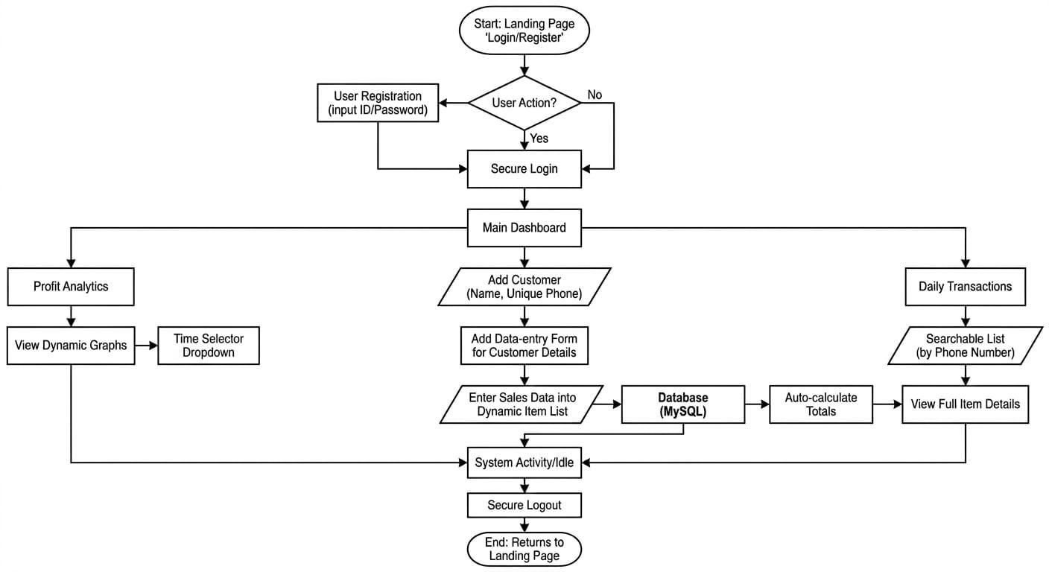
Working flow

Slide 10




Experimental Setup
Technologies Used:
Frontend: HTML, CSS, JavaScript
Backend: Node.js
Database: MySQL
Tools: VS Code, Web Browser, MySQL Server

Slide 11

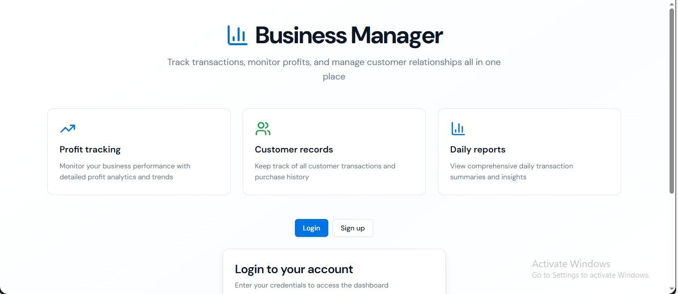
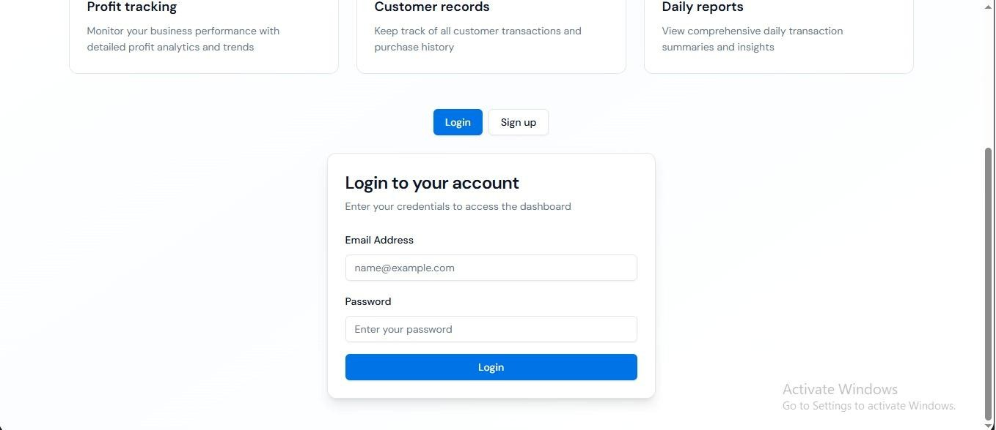
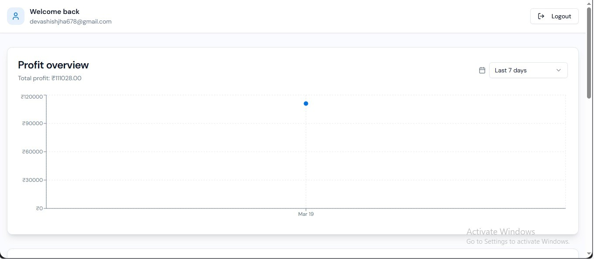
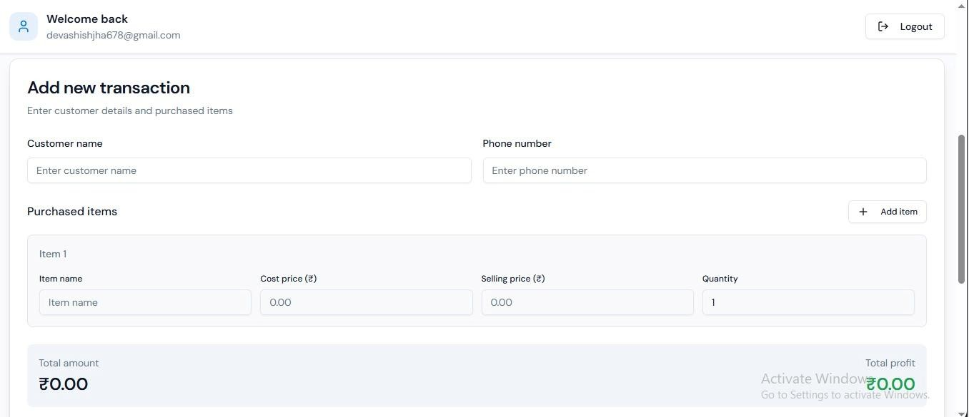
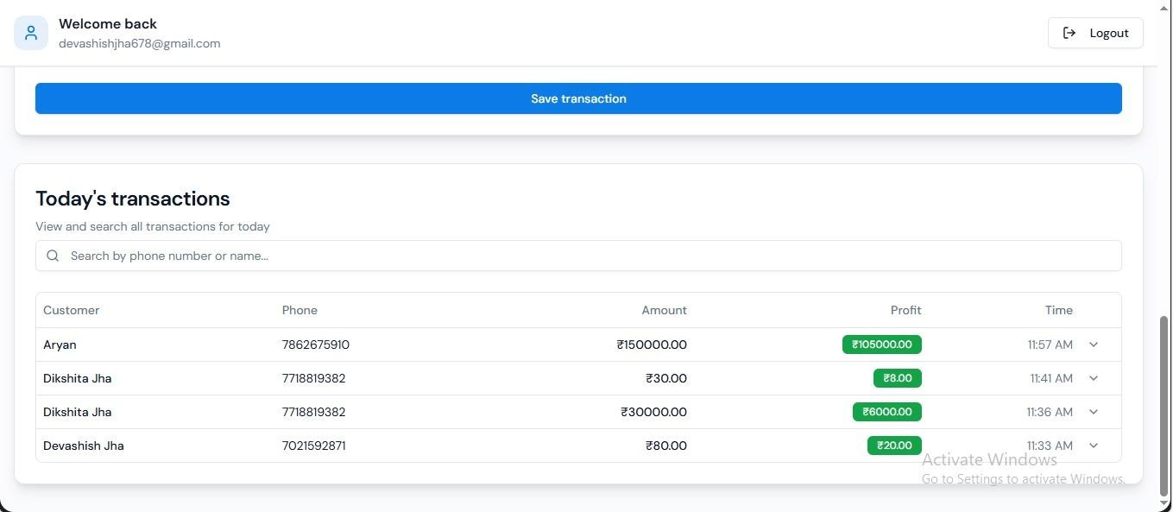
Implementation

Slide 12

Result & Analysis
Result Achieved
Reduced manual workload by approximately 60%
Improved record management efficiency
Faster access to customer and sales data
Automated calculation of profit and sales
Analysis of the system
Dashboard provides real-time business overview
Digital storage minimizes data loss risk
History tracking improves decision making
Simplifies daily business operations

Slide 13
Conclusion and Future work
Conclusion: In conclusion, the proposed Small Business Customer Management System simplifies customer and sales record management by providing a digital, organized, and efficient platform for small business owners.
Future work
Integration with cloud storage for data backup
Mobile-friendly application development
SMS or WhatsApp customer notification feature
Multi-user access for staff management

Slide 14

References
Zoho CRM — Web-based CRM system
Link:https://www.zoho.com/en-in/crm/
2. SalezShark
Link:https://www.salezshark.com/crm/web-based-crm-solutions 3.Catalystk Web-Based CRM for Small Business
Link:https://www.catalystk.com/web-based-crm-software

Slide 15
Thank You...!!

